Slide 1
TNSDC-Generative AI
SIGN RECOGNITION USING CNN
Presented by : KARTHIKEYAN S,
au211521104068,
Pre-Final Student,
Computer Science and Engineering,
Panimalar Institute of Technology.

Slide 2

OUTLINE
Problem Statement
Proposed Solution
System Approach
Algorithm
Result
Conclusion
References

Slide 3
PROBLEM STATEMENT
The current gap between sign language users and others hinders communication. This project aims to bridge this gap by developing a CNN-based system for accurate sign recognition. Challenges include variations in signs and real-time performance demands. Our goal is to design a CNN model that can effectively identify a wide range of signs despite these challenges, achieving high accuracy and real-time functionality. This system has the potential to revolutionize communication accessibility, enabling real-time translation, improving sign language education, and fostering inclusivity in public spaces.

Slide 4
PROPOSED SOLUTION
Data Acquisition and Preprocessing:
Build a large and diverse dataset of sign language images or video frames.
Include variations in hand posture, lighting, background, and potentially regional variations.
Preprocess the data: resize images, normalize pixel values, and consider data augmentation techniques (flipping, rotation) to increase variation and prevent overfitting.
CNN Model Design:
Design a CNN architecture with convolutional layers for feature extraction. These layers will learn to identify edges, shapes, and other key features of signs.
Include pooling layers for dimensionality reduction and capturing spatial invariance (recognizing signs regardless of small position shifts).
Employ activation functions (e.g., ReLU) to introduce non-linearity and improve model capacity.

Slide 5
SYSTEM APPROACH
Hardware:
CPU: The system requires a CPU with sufficient processing power to handle the computational demands of Convolutional Neural Network (CNN) training and inference. A multi-core processor, preferably with a clock speed of at least 2 GHz or higher, is recommended.
Memory: A minimum of 8 GB RAM is recommended for smooth operation, especially during model training, where large datasets are processed. More RAM may be required for handling larger datasets or concurrent user requests.
Internet Speed: A stable internet connection is necessary for downloading and updating Python packages, model weights, and serving the web application. A broadband connection with a minimum download speed of 5 Mbps and upload speed of 1 Mbps is sufficient for most purposes.

Slide 6
SYSTEM APPROACH –CONT.
Software:
Python: The system is built using Python programming language
Pandas: Pandas is a software library written for the Python programming language for data manipulation and analysis. In particular, it offers data structures and operations for manipulating numerical tables and time series.
NumPy: NumPy is a fundamental package for scientific computing in Python, essential for handling multidimensional arrays and mathematical operations. It is used extensively for data preprocessing, manipulation, and numerical computations within the CNN model.
TensorFlow: TensorFlow is a free and open-source software library for machine learning and artificial intelligence. It can be used across a range of tasks but has a particular focus on training and inference of deep neural networks

Slide 7

ALGORITHM
Data Prep: Gather a big, varied sign image/video dataset and pre-process it (resize, normalize, etc.).
Build the CNN: Design a CNN with layers that extract features (convolution), reduce data (pooling), and classify signs (fully-connected).
Train and Evaluate: Train the CNN on the data, using validation to prevent overfitting, then test on unseen data to see how well it generalizes.
Enhance (Optional): Use pre-trained models (transfer learning) or isolate hands for better recognition.
Real-time (Optional): Optimize the model, build a system to capture video, process frames, and display/translate recognized signs.

Slide 8
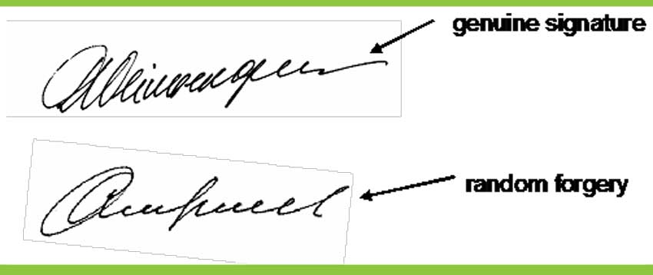
RESULT
Training The Model
Figure 1
8

Slide 9
Conclusion
CNNs hold promise for robust signature recognition. They can learn the intricate variations in penmanship, pressure, and stroke patterns that define a signature. However, challenges remain. Forgeries can mimic genuine signatures, and background clutter can confuse the model. Training on a massive and diverse dataset is crucial, along with techniques to isolate the signature itself. By addressing these challenges and leveraging CNNs' feature learning capabilities, we can develop highly accurate and secure signature recognition systems.
9

Slide 10
REFERENCES
Tensorflow: https://www.tensorflow.org/
Numpy: https://numpy.org/
Pandas: https://pandas.pydata.org/
10

